Slide 1
Transformer Review
By Dequan Er

Slide 2

About
Dequan Er, Ph.D.
Lead Data Scientist @ NDR
erdeq.upenn@gmail.com
LinkedIn:
https://www.linkedin.com/in/dequan-er-69518643/

Slide 3
Outline
Introduction
Model architecture
Result
Derived models
Applications

Slide 4
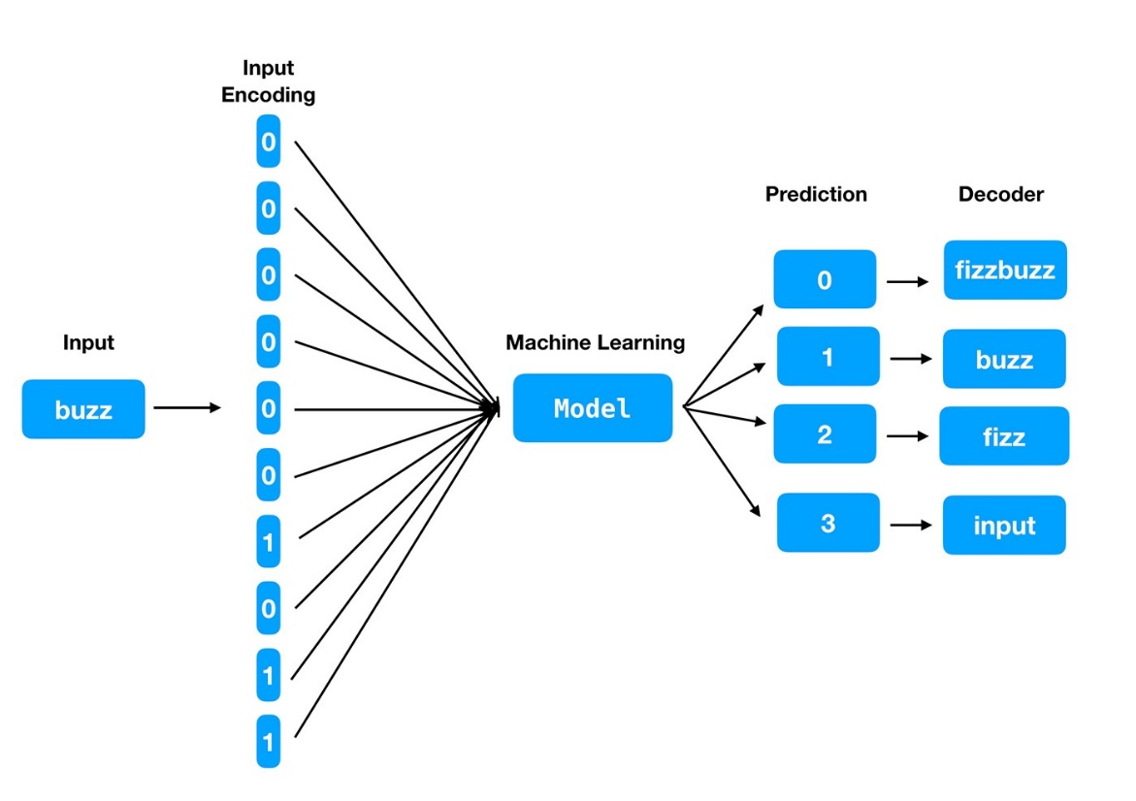
Introduction
From Sequence Modeling to Attention (2017)
From NLP(Nature Language Processing) problem
RNN (Recurrent Neural Network), LSTM (long short-term memory networks), GRU (Gated Recurrent Unit)
From recurrent language models to encoder-decoder model
H_{t-1} to h_{t}
Hard to parallelize
Long sequence memory lose, large H_{t}
Attention used from encoder to decoder
Derivatives of Transformers
BERT (Bidirectional Encoder Representations from Transformers 2018) https://arxiv.org/abs/1810.04805
GPT3 (Generative Pre-trained Transformer 2020)
ChatGPT(2022) https://openai.com/blog/chatgpt/
From NLP to audio, video, etc.
Notes:
Bidirectional Encoder Representations from Transformers (BERT)
Generative Pre-trained Transformer

Slide 5
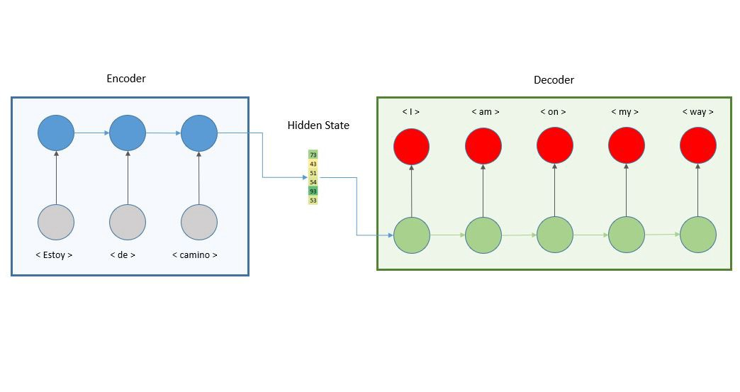
Model Architecture
Structure of encoder-decoder
Encoding-decoding architecture is the basic of transformers

Slide 6
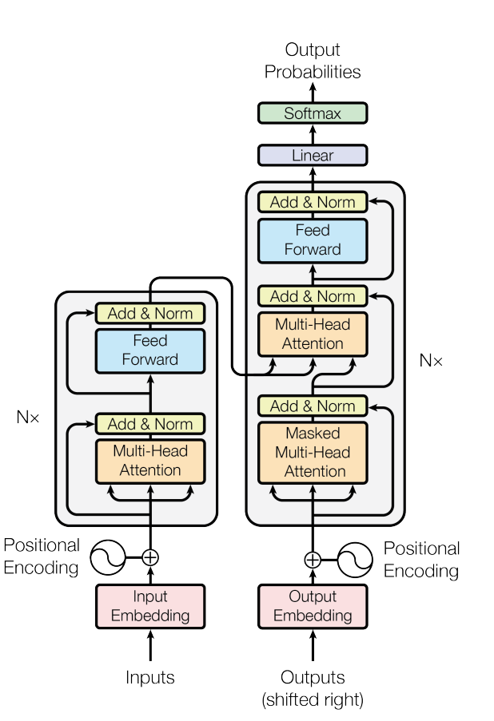
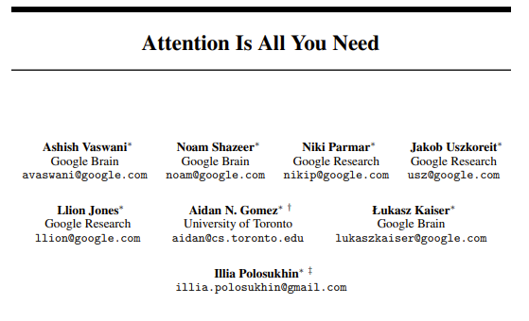
Model Architecture
31st Conference on Neural Information Processing Systems (NIPS 2017), Long Beach, CA, USA.

Slide 7
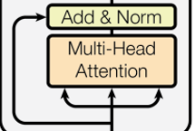
Model Architecture
Attention layer: mapping a query and a set of key-value pairs to an output in vector form. {Q,K,V}
Q¹
Q²
Similarity in k space
Using Q·K = |Q||K|cos(θ)
k
v

Slide 8
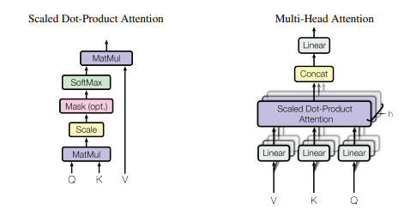



Model Architecture
Scaled dot-product attention
d_{k}
d_{k}
m
d_{k}
Q
K^{T}
V
$$∙$$
m
=
n
m
n
Role of Mask: see until K_{t}
Notes:
Demo on mask layer

Slide 9
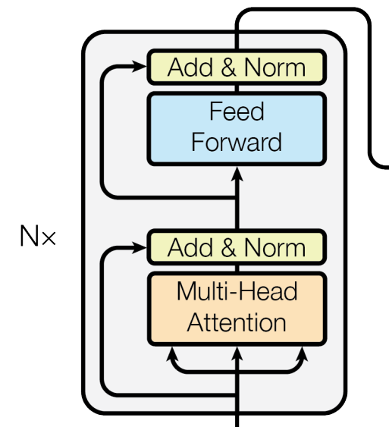
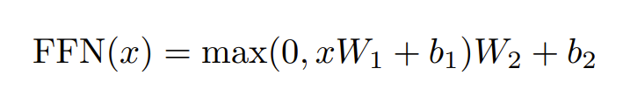
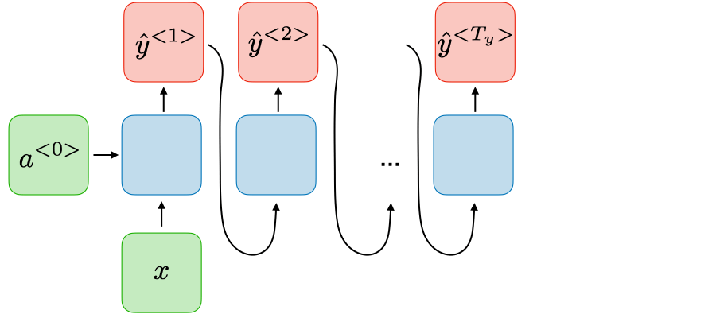
Model Architecture
Position-wise Feed-Forward Networks
Positional Encoding
Ensure sequence of tokens
Why it can extract information in a non-sequencial way?
Notes:
Drawing of layer
H_t = k1, k2, …k_t-1 kn masked

Slide 10
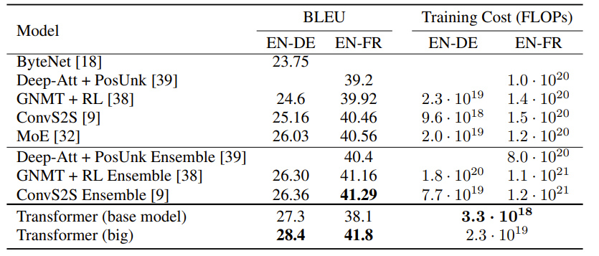
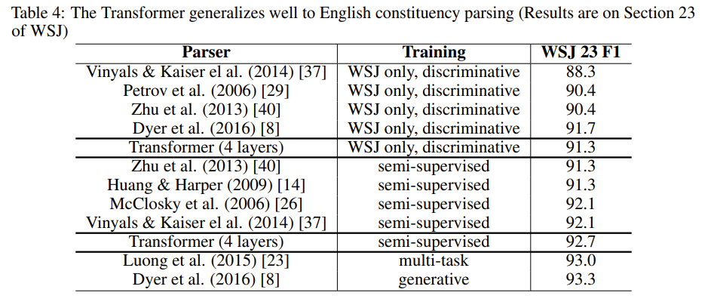
Result

Slide 11
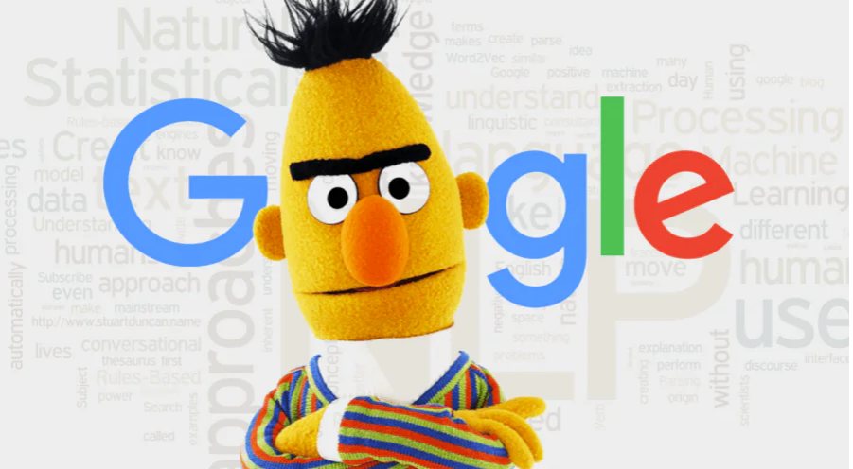
Derived models
BERT: https://www.codemotion.com/magazine/ai-ml/bert-how-google-changed-nlp-and-how-to-benefit-from-this/
GPT: https://huggingface.co/docs/transformers/model_doc/openai-gpt
GPT3: https://github.com/openai/gpt-3
ChatGPT: https://openai.com/blog/chatgpt/
It has 175 Bn parameters

Slide 12
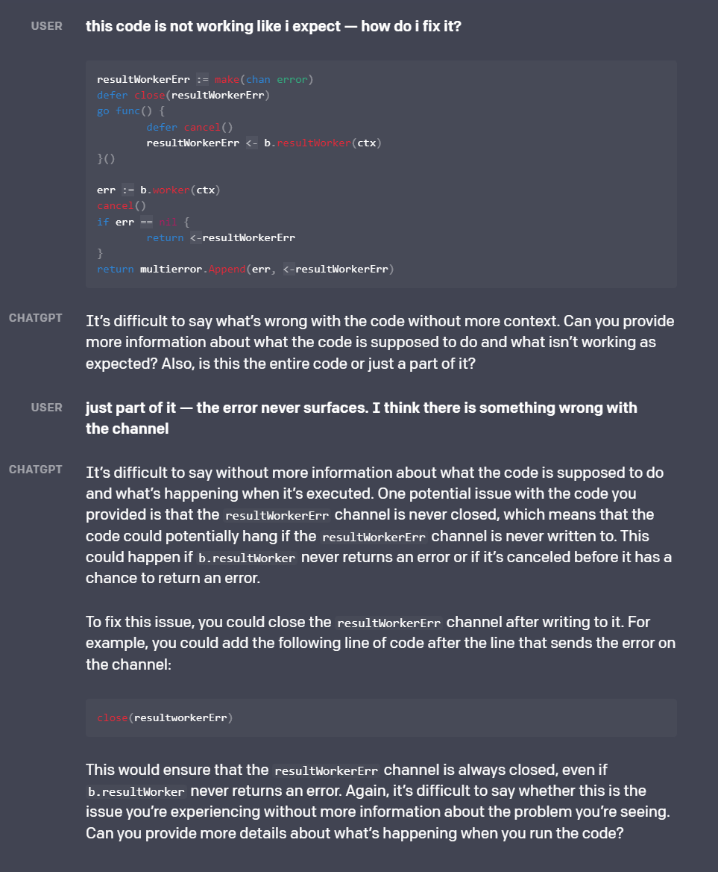
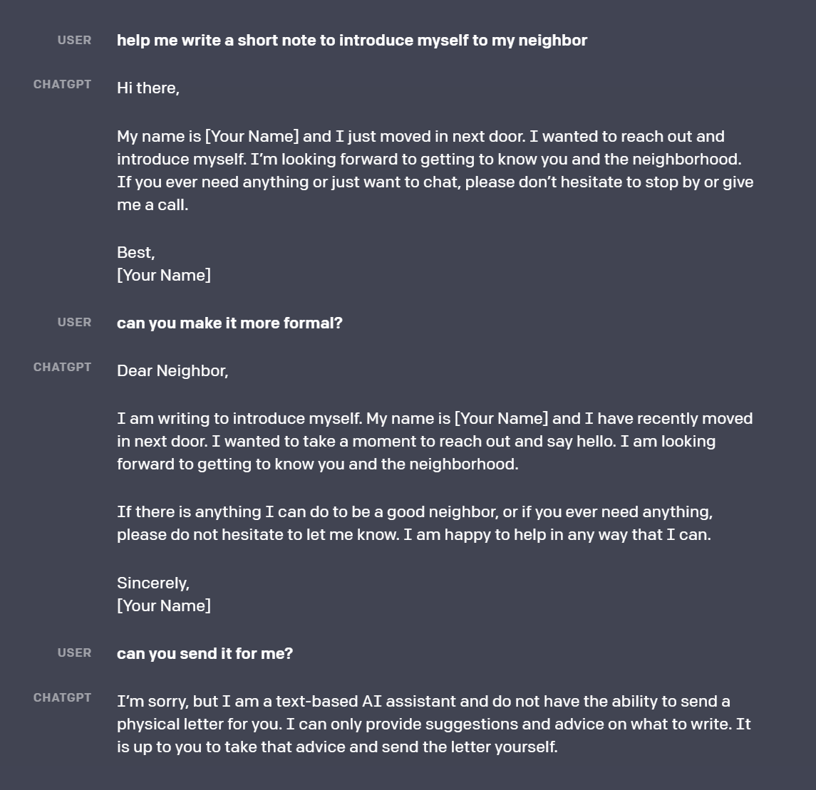
ChatGPT

Slide 13
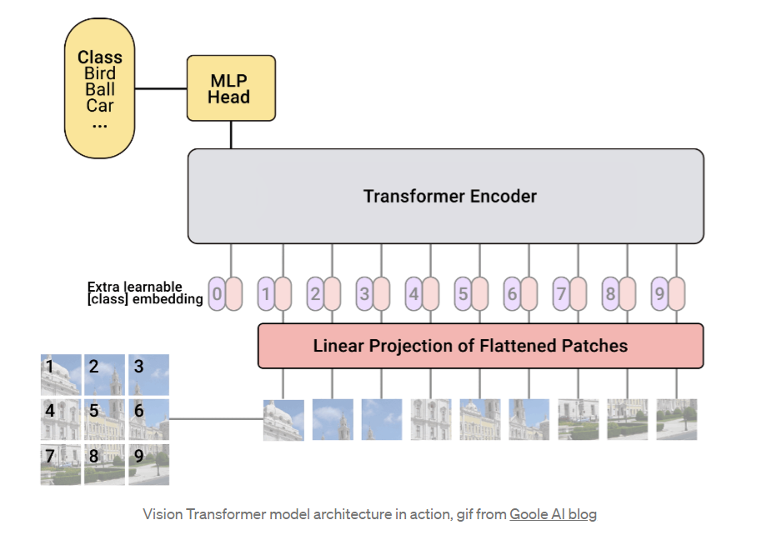
Applications
NLP
Sentiment analysis
Vision Transformers
ViT (2020) https://arxiv.org/pdf/2010.11929.pdf
Swin Transformer (2021) https://arxiv.org/pdf/2103.14030.pdf
DINO https://arxiv.org/pdf/2104.14294.pdf
DETR https://arxiv.org/pdf/2104.14294.pdf
Audio
Video
TimeSformer https://arxiv.org/pdf/2102.05095.pdf

Slide 14
Q&A

